Slide 1
Dynamic Blacklist for Firewalld
By Rick Awalias and Avinash Konatala
Project : Python Scripting and Programming
Instructor : Prof. Frank Breitinger

Slide 2
Motivation :
In the present world, We know Technology has reached sophisticatedly higher levels in data securing, equally cyber crimes. With an enthusiasm towards network security we came up with this project The “Dynamic Blacklist for Firewalld” which focuses on an idea which can better the security level in Host to Sever communication.

Slide 3
Idea is ?
Only so much you can do to harden a server
web server - TCP 80/443 open to the world
Intrusion Prevention System with packet inspections are $$$
We set out to programmatically create a real-time blacklist of hostile IP’s and auto-block them on clients
Intrusion Prevention System
Simplifying:
Using a HoneyPot to generate a list of known hostile IP addresses. Remote hosts automatically retrieve the list and reconfigure their local packet filter to deny these hostile IP's

Slide 4
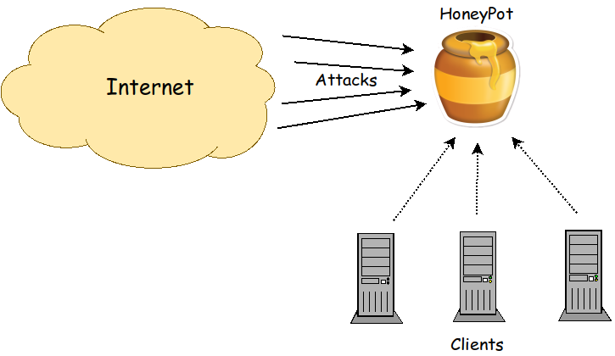
What we needed ?
Four Components:
a Server
a Client
VM – “Digital Ocean”
SQLite db
Architecture

Slide 5
We initially started with (3) cloud providers running (3) HoneyPots but settled on a single HoneyPot running at Digital Ocean. Logs from multiple HoneyPots would be ideal and is easily done. We did see the most attacks on the AWS VM, presumably because they are the most popular. In the end, we wanted to minimize out-of-pocket costs and also the DO VM had a routable IP address which simplified setup.
We considered running a web server on the HoneyPot to separate port scans from hosts running exploits against the web server but decided to use Firewalld denials exclusively.
Scope:

Slide 6
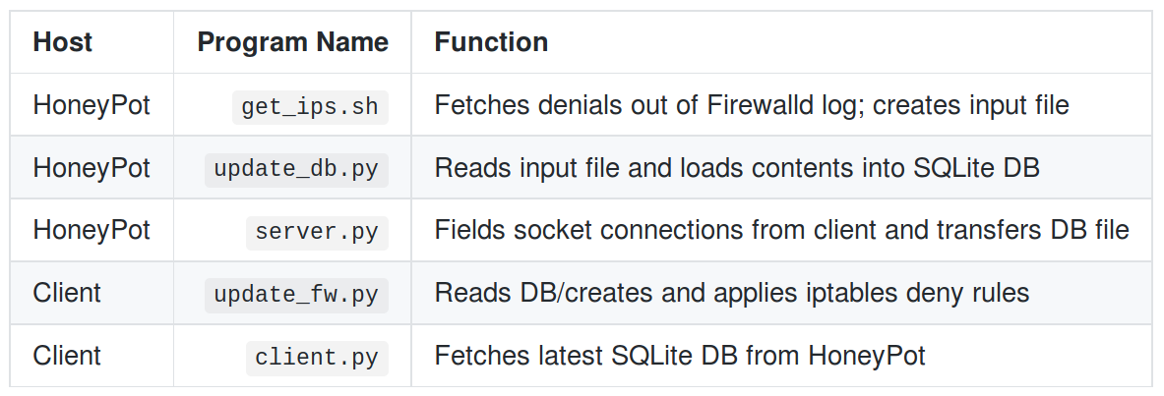
How we did?
First we started with building server, The VM we bought on Digital Ocean we have chosen our server will be running on this space, while our hosts can be any Linux/windows based machines.

Slide 7
Honeypot Configuration:
Vanilla CentOS7 running Firewalld
Installed Python3
Configured Firewalld to log all denials
Only allow inbound ssh from select networks
Installed server.py, get_ips.sh, and update_db.py

Slide 8
Client Configuration:
Server you want to protect
Linux/Firewalld/Python3
Installed client.py, update_fw.py
Latest SQLite DB of hostile IP’s is downloaded periodically (cron)
New IP’s are blocked via IPSet/Firewalld commands crafted by update_fw.py
Takes ~1min to add ~27k IP’s

Slide 9
How it works?
Example denial on HoneyPot
Nov 26 20:02:21 luigi kernel: FINAL_REJECT: IN=eth0 OUT= MAC=76:db:31:2d:76:4c:cc:e1:7f:a8:17:f0:08:00 SRC=95.68.93.214 DST=67.205.131.5 LEN=40 TOS=0x00 PREC=0x00 TTL=54 ID=54928 PROTO=TCP SPT=41916 DPT=23 WINDOW=54468 RES=0x00 SYN URGP=0
Parsed down to:
Nov 10 22:13:09 101.109.106.178
And loaded into SQLite DB

Slide 10
How it works? CONT’D
Sockets are used to enable a TCP file transfer initiated by the client(s)
Access can be locked down via Firewalld rules on the HoneyPot (add each client IP)
Client read the IP’s from the DB and add IP’s new ones to the IPSet blacklist

Slide 11
Reflection:
Got bogged down w/ some non-Python things like finding the most efficient way to deny thousands of IP’s (IPSet)
Created a Python script to spoof IP’s in an effort to live-test but it turns out the Linux IP stack is too smart – ignored the incoming traffic w/o logging a denial.
Manual testing proved that the system functioned well.

Slide 12


Slide 13
Conclusion:
Several Honeypots could be deployed in multiple locations to create a larger pool of known hostile IP addresses.
Encrypt the file transfer
Use key-based authentication to authorized clients/verify server.
Leverage the ipset del feature to age off IP's. The date/time stored in the SQLite db could be used to roll off IP's after a set time, say 30 days

Slide 14


Query?

